Slide 1
SOFTWARE REVIEWS

Slide 2
A review is a systematic examination of a document by one or more people with the main aim of finding and removing errors early in the software development life cycle. Reviews are used to verify documents such as requirements, system designs, code, test plans and test cases.
Reviews are usually performed manually

Slide 3
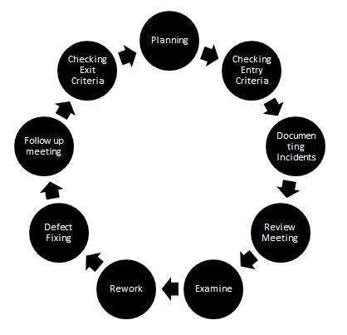

Slide 4
Types of Software Reviews
Software Peer Review
Software Management Review
Software Audit Review

Slide 5
Peer review is the process of assessing the technical content and quality of the product and it is usually conducted by developers.
Peer review is performed in order to examine or resolve the defects in the software, whose quality is also checked by other members of the team.

Slide 6
Code Review
Computer source code is examined in a systematic way.
Pair Programming
It is a code review where two developers develop code together at the same platform.
Walkthrough
Members of the development team present their work and other interested parties and the participants ask questions and make comments about defects.

Slide 7
Technical Review
A team of highly qualified individuals examines the software product for its client’s use and identifies technical defects from specifications and standards.

Slide 8
Software Management Review evaluates the work status. In this section decisions regarding downstream activities are taken.

Slide 9
Software Audit Review is a type of external review in which one or more critics, who are not a part of the development team, organize an independent inspection of the software product and its processes to assess their compliance with stated specifications and standards. This is done by managerial level people.

